Slide 1
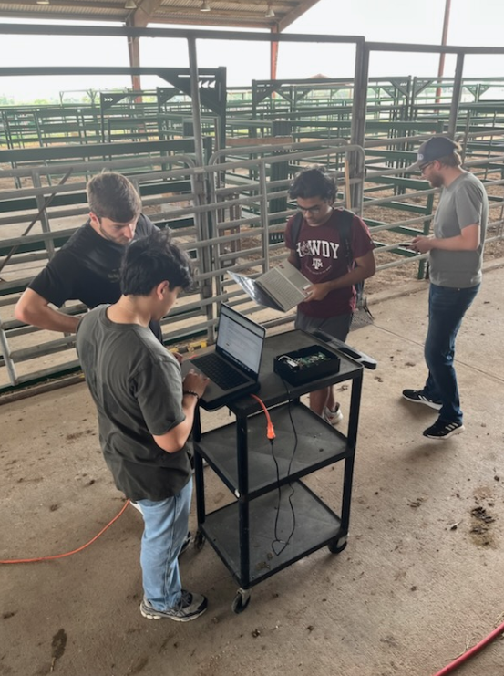
Team 28
Livestock Gas Monitor
Final Demo
Matthew Owen, Joaquin Salas, Blake Schwartzkopf, Tanmay Sarkar
Sponsor: Global Hawk Solutions LLC (Justin Houck)
TA: Vishwam Raval

Slide 2
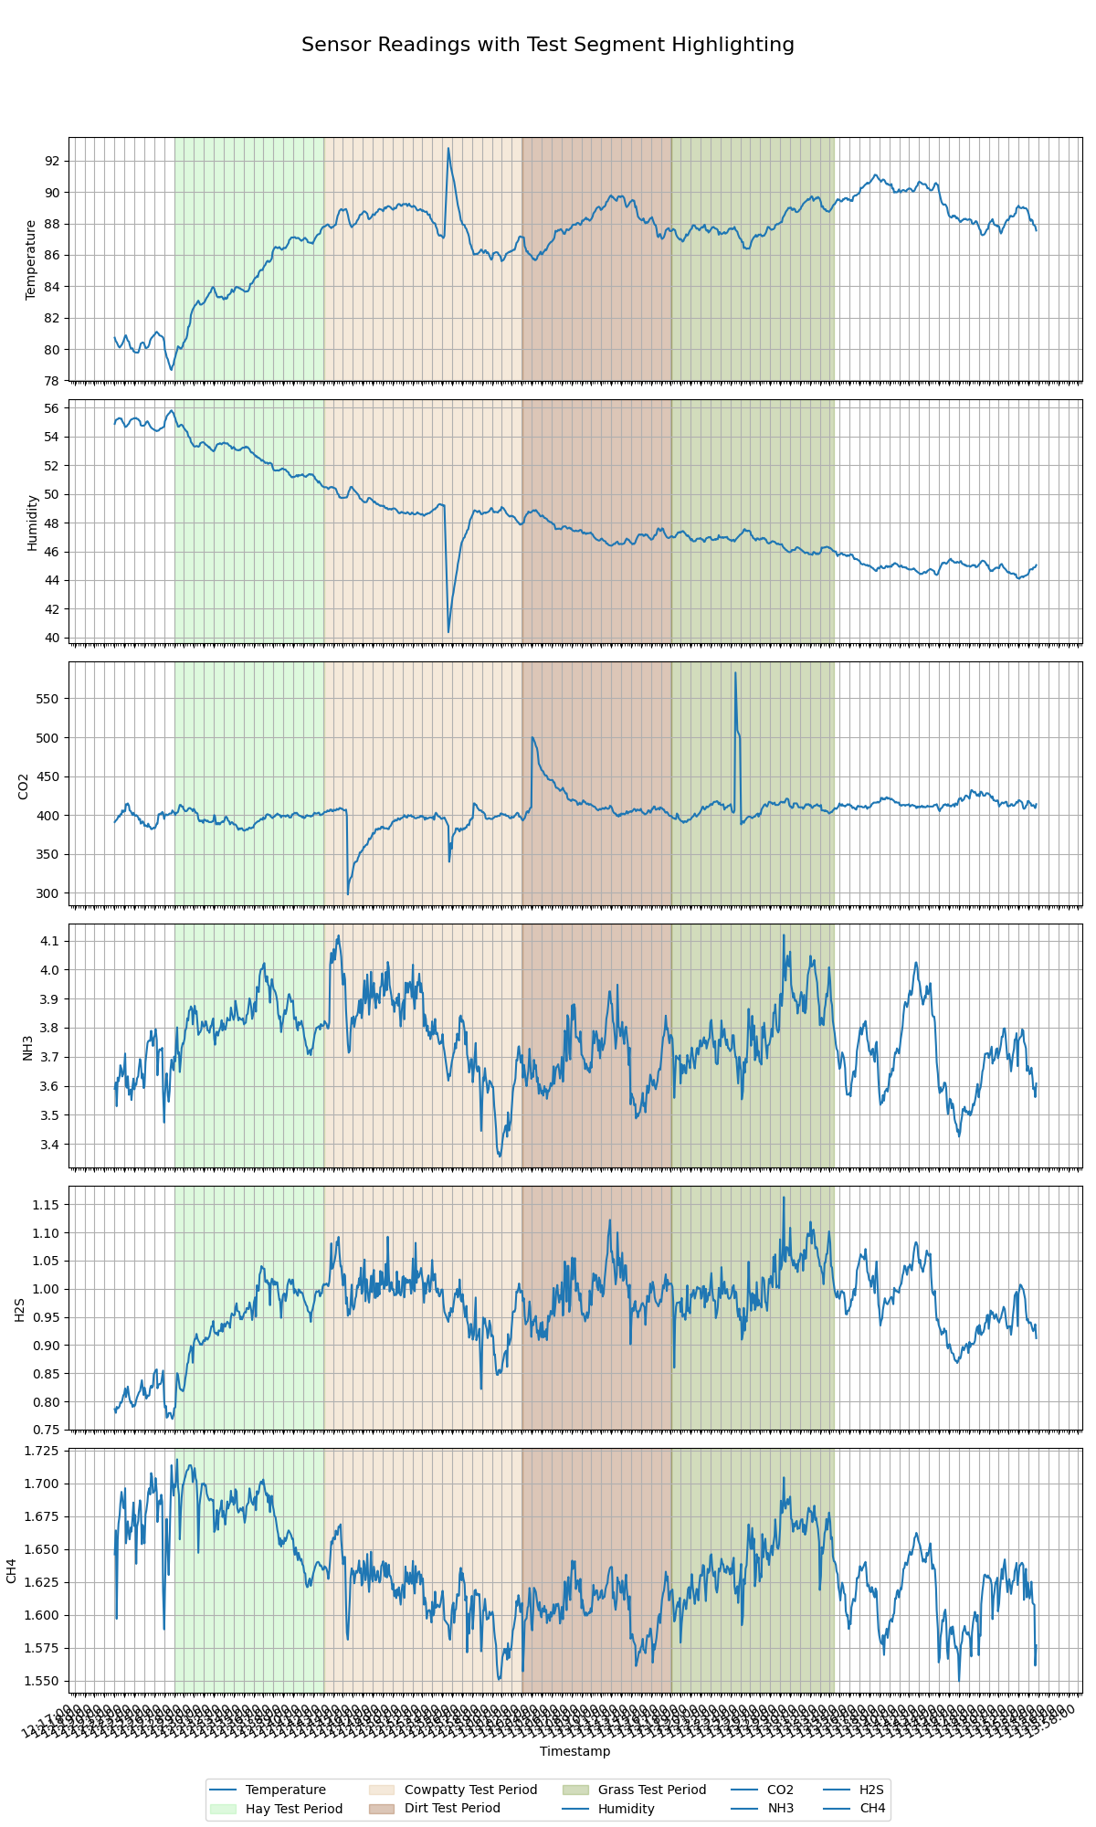
Two Successful Farm Visits to collect data
Farm visit #2: Link:
https://www.youtube.com/watch?v=4liHx-7FbGY&t=7s
Justin Houck (our sponsor) said:
“Project operates within expected operational scope and exceeds expectations in IoT connectivity and hotspot capability.”

Slide 3
Matthew Owen- Power
Requirement | Target Spec | Result
Correct Output Voltages | 5,-8,3.3 V within +-1V | Met
Load Requirements met | PCB can supply desired voltages at full load of other boards/parts | Met
Housing Unit Design | Design housing unit to fully protect and mount all boards/parts | Met

Slide 4
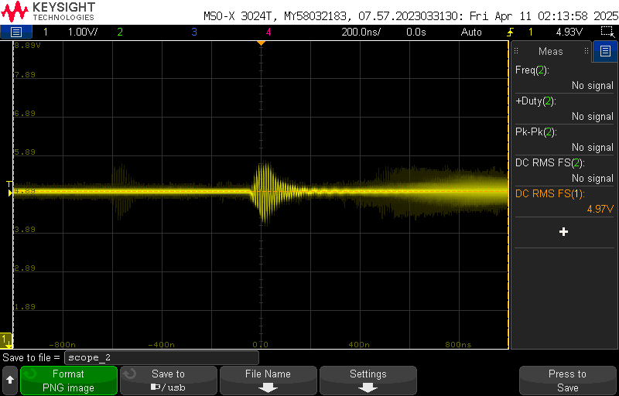
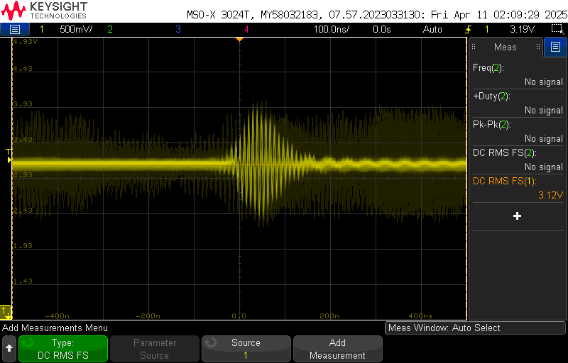
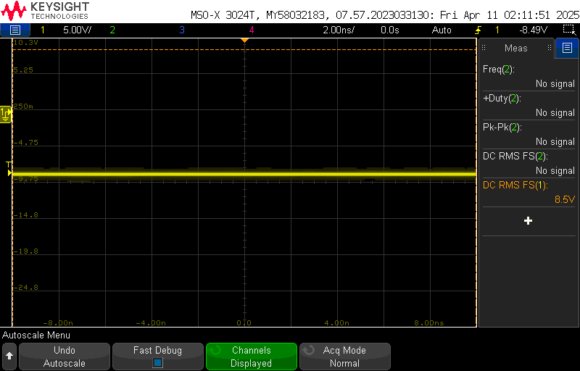
Output Voltages under full load conditions
5V
3.3V
-8.5V

Slide 5
Blake Schwartzkopf - Sensor
Requirement | Target Spec | Result
I2C Communications | Arduino I2C scanner code detects address for CO2 and temperature sensors. | Met
SPI Communications | Arduino SPI code can read analog input from analog to digital converter. | Met
Microcontroller Flash | Microcontroller can upload code. | Met
Voltage Divider and Op Amp | Voltage divider cuts voltage in half. Unity gain op amp does not change the voltage. | Met

Slide 6
Joaquin Salas - MCU & Data Transmission Subsystem
Programmed ESP32-S3 in ESP-IDF (C):
Several GPIO, Built in Wi-Fi/Bluetooth, low-level control, managing tasks
Integrated sensors:
I2C: HDC1000 (Temp/Humidity), SCD41 (CO₂ + Temp/Humidity)
Analog: MQ-4, MQ-136, MQ-137 via AD7718 Analog-Digital Converter
Developed Wi-Fi/MQTT transmission to AWS IoT for real time data visualization
Requirement | Target Spec | Result
Read Analog Sensor Data | ±1% error max across 0-2.5V | Minimum Error: 0.000001% Maximum Error: 0.00160% Average Error: 0.00017%
Read Digital Sensor Data | Digital sensor initializes and reports valid CO₂, temperature, and humidity values | Successful sensor initialization and realistic environmental readings under test conditions
Transmit Sensor Data | Send all sensor values every 5s to AWS MQTT broker without data loss | 0 data loss, corrupted data, repeated data
Wi-Fi Range and Stability | Maintain stable transmission over extended time periods (30 min, 1 hr, 2 hrs, 3 hrs) | Successful under ideal Wi-Fi. Under busy Wi-Fi network/weak signal: Wi-Fi reconnects every 5-20 data transmissions.

Slide 7
Input Value | Output Value | Corrected Value | Error (%)
0.25 | 0.272611 | 0.24996 | 0.00016
0.3 | 0.3214 | 0.299959 | 0.00014
0.35 | 0.370206 | 0.349975 | 0.00007
0.4 | 0.419002 | 0.399982 | 0.00005
0.45 | 0.467812 | 0.450002 | 0.00000
0.5 | 0.516805 | 0.500005 | 0.00001
0.55 | 0.565394 | 0.550004 | 0.00001
0.6 | 0.614412 | 0.599039 | 0.00160
0.65 | 0.6629 | 0.649928 | 0.00011
0.7 | 0.710648 | 0.699913 | 0.00012
0.75 | 0.760481 | 0.749993 | 0.00001
0.85 | 0.858065 | 0.849934 | 0.00008
0.95 | 0.955856 | 0.949924 | 0.00008
1 | 1.00447 | 1.00046 | 0.00046
1.25 | 1.24846 | 1.250016 | 0.00001
1.5 | 1.429238 | 1.499936 | 0.00004
1.75 | 1.736281 | 1.749929 | 0.00004
2 | 1.980254 | 1.999953 | 0.00002
Validation:
Read Analog Sensor Data (3 MQ-Series Sensors), Read Digital Sensor Data (Temp + Humidity Sensor)
Analog input voltage reading - output value vs. corrected value. Equation used: corrected_voltage = (voltage - 0.0287) / 0.9758;
Results:
Very low error when reading output voltages from analog gas sensors.
Temperature, Humidity, CO2 read realistic values that align with existing data
From 11:00 AM to 2:00 PM on April 3rd:
Temp (°F): Min = 81°F, Max = 88°F, Average = 85.25°F
Humidity (%): Min = 61%, Max = 79%, Average = 68%
CO₂ (ppm): 400-1000ppm: Typical CO2 levels found indoors
 | Temp (°F) | Humidity (%) | CO₂ (ppm)
min | 76.85 | 51.55 | 390.0
max | 87.06 | 60.45 | 764.0
mean | 84.88 | 56.81 | 475.85

Slide 8
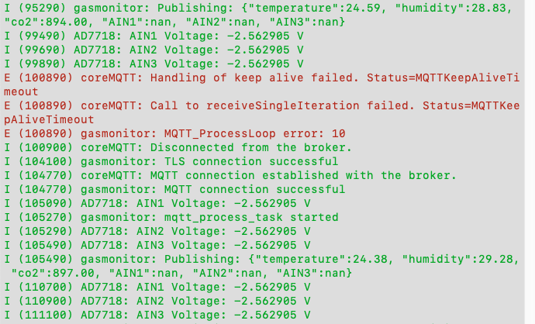
Data Transmission Reliability
Data is successfully transmitted every 5 seconds, additional error handling added - reconnection when Wi-Fi signal is weak or MQTT keepalive timer expires resulting in constant data transmission. (weak Wi-Fi signal delays data transmission with Wi-Fi reconnecting every 5-20 transmissions.)

Slide 9
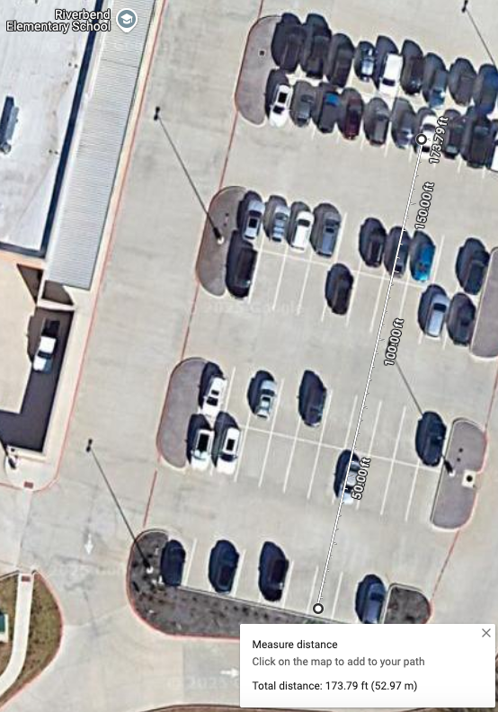
Data Transmission Reliability
Outdoor Wi-Fi range test with ESP32:
https://drive.google.com/file/d/1TmmzWwZ93stNo3J1Im81Ky9rzCDs-dyj/view?usp=drive_link
Wi-Fi on the ESP32 can transmit up to 55 yards before the signal weakens and reconnection becomes much more frequent. This can now be solved with moving to MQTT instead of TCP along with Wi-Fi provisioning on ESP32 due to ability to connect to cell phone hotspot

Slide 10
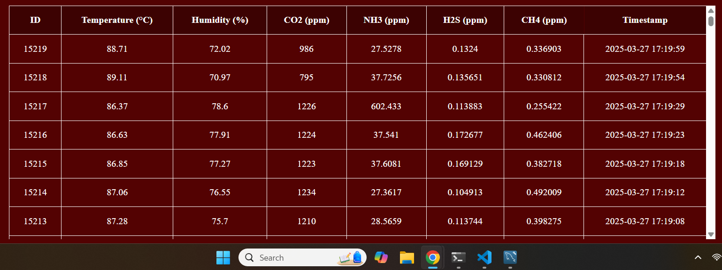
I2C and SPI data being received

Slide 11
Tanmay Sarkar - Database & Web Application Subsystem
Requirement | Target | Result
Password/2FA Verification | Database backend is secure | Database is AWS protected. Every user has to create an account and be verified in order to be added to the AWS account
Data transmission rate | Successful data transmission < 5 seconds | Successful & constant data transfer - 1 datapoint every 5 seconds.
Deploy web application | Website stays up 24/7. | Few small moments where website loses connection health, but it goes back up within the next minute.

Slide 12
